Slide 1
How to read a research paper

Slide 2
Characteristics of Research Papers
Condensed Style
  Page Limits
  Target Audience: Researchers in Field
  Intended message ≠ Message you seek…
Reading as a novice
  Seek supplementary readings
  “Active Reading”
  Multiple, targeted readings

Slide 3
Types of Research Papers
Conference Papers
  Strict Page Limits (10-12 pages)
  Peer-reviewed (I.e., some quality control)
  Most visible venue for Systems Research
Journal Papers
  No (or very generous) page limits
  Peer-reviewed
  Expanded version of 1+ conference papers

Slide 4
Types of Research Papers (cont.)
Workshop Papers
  Strict Page Limits (10-12 pages)
  Peer-reviewed
  Designed to present early work (feedback-oriented)
Technical Reports
  Internal (Department) Publications
  No Page Limits
  Not peer-reviewed
  Best source of details

Slide 5
Active Reading
Questions to ask as you read…
  What are the motivations for this work?
  What is the proposed solution?
  What is the evaluation methodology?
  What are the contributions?

Slide 6
Active Reading
Multiple readings
  1st reading:
    Understand: motivation, contributions
    High-Level Understanding: solution, evaluation criteria
    Main Focuses: Introduction, Related Work, Conclusions
  2nd, 3rd readings:
    Deep understanding of solution, evaluation…

Slide 7
Active Reading
Deep Understanding of Solution
  If an algorithm: trace on examples
  If an architecture: trace execution
  “Paper-and-pencil” reading
Deep Understanding of Evaluation
  If a key proof: trace the steps of the proof
  If empirical: look for anomalies and explanations for them…

Slide 8
If You’re A Presenter…
Look for background material…
  Accompanying technical report
  Follow-up journal paper
  Survey on the area
  Related Work (paper bibliography+)
  Tutorial on the area
Indexes are your friend…
  Good resources in this area
  Google

Slide 9
How to give a good research talk
Adapted from a talk by
Simon Peyton Jones
Microsoft Research
See http://research.microsoft.com/Users/simonpj/papers/giving-a-talk.htm

Slide 10
Research is communication
The greatest ideas are worthless if you keep them to yourself

Slide 11
Do it! Do it! Do it!
Good talks are a fundamental part of research excellence
Invest time
Learn skills
Practice

Slide 12

Giving a good talk
This presentation is about how to give a good research talk
What your talk is for
What to put in it (and what not to)
How to present it

Slide 13

The purpose of your talk…
..is not:
To impress your audience with your brainpower
To tell them all you know about your topic
To present all the technical details

Slide 14

The purpose of your talk…
..but is:
To give your audience an intuitive feel for an idea
To make them foam at the mouth with eagerness to (re)read the paper
To engage, excite, provoke them

Slide 15
Your audience…
The audience you would like…
Will have read the paper as many times as you
Will have read all background papers
Thoroughly understand all the relevant theory of cartesian closed endomorphic bifunctors
Are all agog to hear your interpretation of the paper
Are fresh, alert, and ready for action

Slide 16
Your actual audience…
The audience you get…
Have read the paper once
Will not have read background material
Have heard of bifunctors, but wish they hadn’t
Have just had lunch and are ready for a doze
Your mission is to
WAKE THEM UP
And make them glad they did

Slide 17

What to put in

Slide 18
What to put in
Outline (1%)
Motivation (20%)
The key idea (79%)
There is no 4

Slide 19
Outlines as Milestone Markers
Rule-of-thumb (presenting, papers, teaching…)
Tell them what you’re going to do
Do it
Tell them what you did
Variations on a theme
Remind them what you’ve done so far
Remind them what you’ve yet to do

Slide 20
Motivation
You have 2 minutes to engage your audience before they start to doze
Why should I tune into this talk?
What is the problem?
Why is it an interesting problem?
Give an example! (e.g. Battlefield monitoring)

Slide 21

The key idea
If the audience remembers only one thing from your talk, what should it be?
You must identify the key idea. “Talked about Query Optimization” is No Good.
Be specific. Don’t leave your audience to figure it out for themselves.
Be absolutely specific. Say “If you remember nothing else, remember this.”
Organize your talk around this specific goal. Ruthlessly prune material that is irrelevant to this goal.

Slide 22
Your main weapon
Examples are your main weapon
To motivate the work
To convey the basic intuition
To illustrate The Idea in action
To show extreme cases
To highlight shortcomings
When time is short, omit the general case,
not the example

Slide 23

What to leave out

Slide 24
Slides You Don’t Understand
Don’t BS! (It is far more transparent than you think)
Getting Caught is Embarassing!
It is OK not to understand some details
  You should demonstrate your effort to understand (I tried to understand X with the following example but got different results)
  You can use this as an opportunity to engage the class…
  … but don’t do this too often!

Slide 25
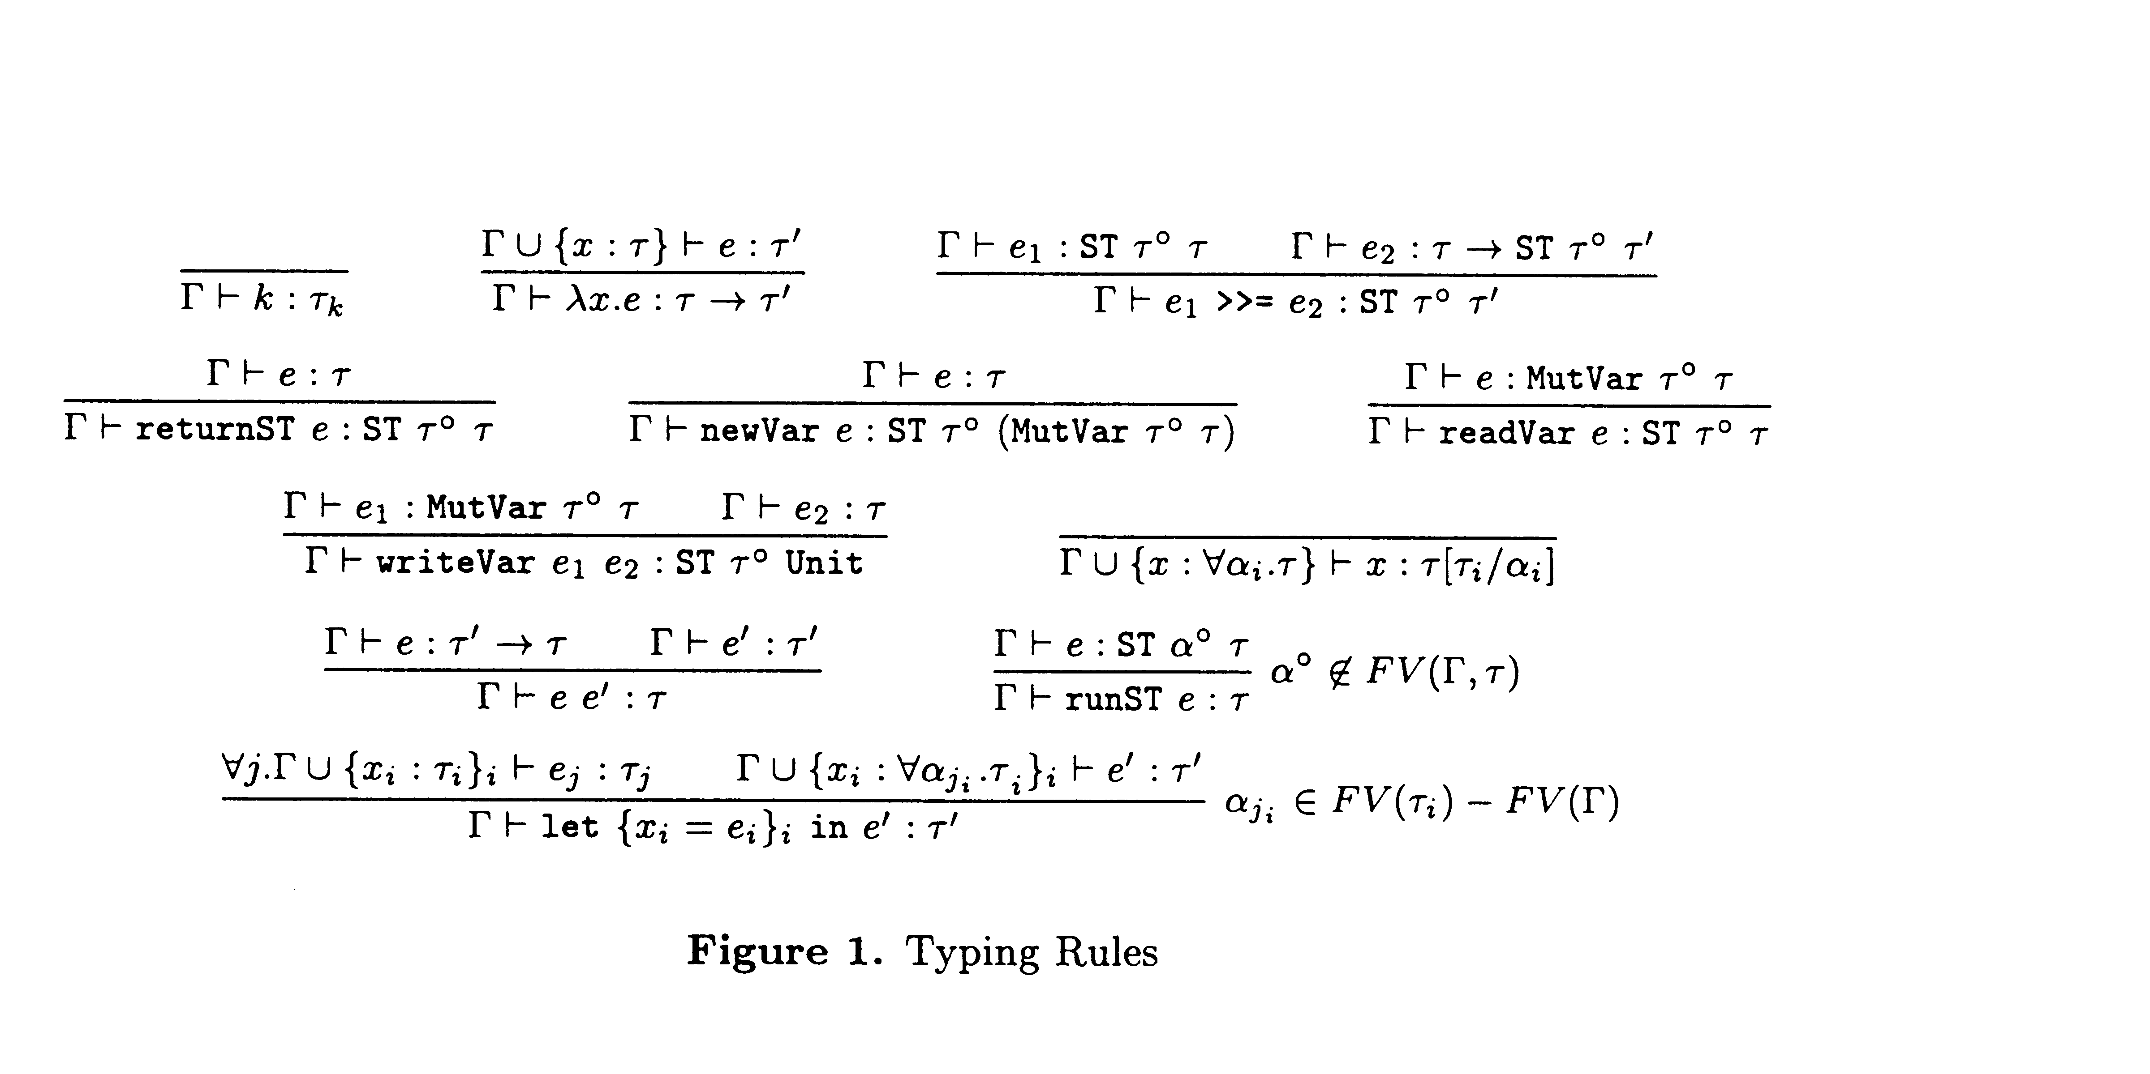
Gory details

Slide 26
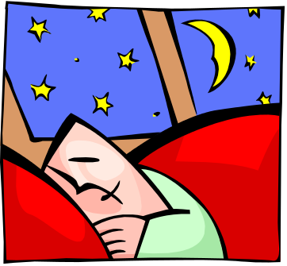
Omit gory details
Even though you spent hours understanding the details, dense clouds of notation will send your audience to sleep
Present specific aspects only
that are relevant to examples
or ideas
Note: Leaving it out doesn’t mean you don’t need to understand it!

Slide 27
Unnecessary Verbiage
Slides that have a lot of text on them put audiences to sleep. Try to avoid writing a “brain dump” on your slide. Your audience will end up reading the slide instead of listening to you (and that’s if you’re lucky) and will quickly lose interest in the talk. Worse, this practice tends to make speakers “read their slides”. YAWN!!!!. Instead…

Slide 28
Avoid Unnecessary Verbiage
Sparse slides
Key points to leave with

Slide 29
Preparing your presentation

Slide 30
2 Weeks Before Presenting…
Read the papers your group will present
Think About How to Integrate the Ideas in Various Papers
Meet with your Groupmates:
  Plan the class. E.g.
    1:40-1:55 - Introduction, Plan for Class
    1:55-2:40 – Paper #1
    2:40-3:25 – Paper #2
    3:25-3:30 – Break
    3:30-4:00 - Paper #3
    4:00-4:30 - Discussion, Integration
  Divide the Work (but plan to keep in touch!)

Slide 31
1 Week Before Presenting…
Meet with your supervisor/professor with a draft of your slides and timeline
Edit slides and timeline
Practice, practice, practice!

Slide 32
An Hour Before Presenting…
Many people experience apparently-severe pre-talk symptoms
Inability to breathe
Inability to stand up (legs give way)
Inability to operate brain

Slide 33
What to do about it
Deep breathing during previous talk
Script your first few sentences precisely
(=> no brain required)
Move around a lot, use large gestures, wave your arms, stand on chairs
Go to the bathroom first
You are not a wimp. Everyone feels this way.

Slide 34
Presenting your talk

Slide 35

How to present your talk
By far the most important thing is to
be enthusiastic

Slide 36
Enthusiasm
If you do not seem excited by your idea, why should the audience be?
It wakes ‘em up
Enthusiasm makes people dramatically more receptive
It gets you loosened up, breathing, moving around

Slide 37
Being seen, being heard
Point at the screen, not at the overhead projector
Speak to someone at the back of the room, even if you have a microphone on
Make eye contact; identify a nodder, and speak to him or her (better still, more than one)
Watch audience for questions… (I ask my share…)

Slide 38
Questions
Questions are not a problem
Questions are a golden golden golden opportunity to connect with your audience
Specifically encourage questions during your talk: pause briefly now and then, ask for questions
Be prepared to truncate your talk if you run out of time. Better to connect, and not to present all your material

Slide 39
Keep To your Timeline!
Absolutely without fail,
finish on time
Audiences get restive and essentially stop listening when your time is up. Continuing is very counter productive
Simply truncate and conclude
Do not say “would you like me to go on?” (it’s hard to say “no thanks”)

Slide 40
There is hope
You will attend 50* as many talks as you give. Watch other people’s talks intelligently, and pick up ideas for what to do and what to avoid.

